Slide 1
Blood groups
Dr. Wafa Mubarak

Slide 2
Objectives:
By the end of this topic the student should be able to :
To define blood group
To identify importance of blood grouping
To discuss types of blood groups
To discuss the problem of Rh –ve in pregnancy.

Slide 3
A blood group:
is classification of blood based on the presence or absence of inherited antigens on the surface of red blood cells (RBCs).

Slide 4
Importance :
Blood transfusion
Exclusion of paternity

Slide 5
types of antigens :
At least 30 commonly occurring antigens and hundreds of other rare antigens are presents .
ABO system
Rh system.
Others : MNS , Ltheran ,kell , kidd . Duffy

Slide 6
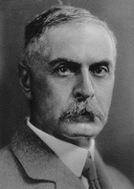
ABO SYSTEM
Discovered in 1900 by Dr. Karl Landsteiner
4 Main Phenotypes (A, B, AB, O)
The ABO gene is autosomal
A and B blood groups are dominant over the O blood group

Slide 7
Formation of ABO antigens (agglutinogens)
From 3 allelic genes: A, B & O.
The H antigen is an essential precursor to the ABO blood group antigens.

Slide 8
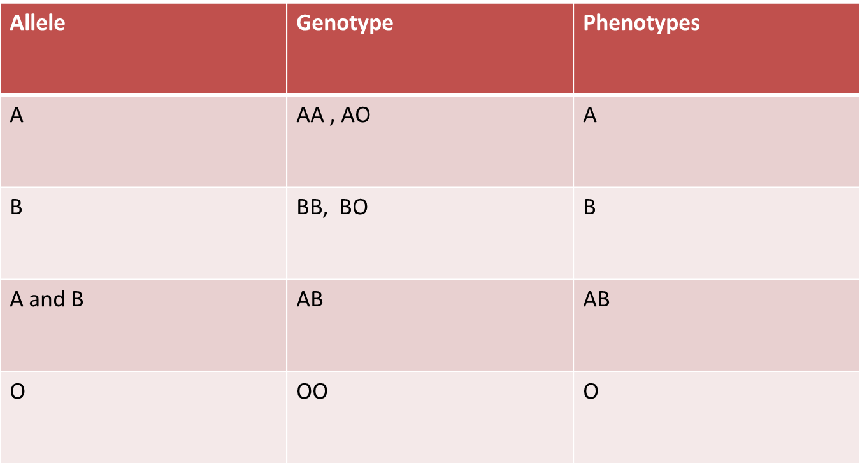

Slide 9
Antibodies (agglutinins)
They occur naturally after birth (2nd – 8th month of life).
The body forms antibodies against antigens not present on the surface of the RBC.

Slide 10
When type A antigen is not present in a person’s red blood cells, antibodies known as anti-A antibody develop in the plasma.
Also, when type B antigen is not present in the red blood cells, antibodies known as anti-B antigens develop in the plasma.

Slide 11
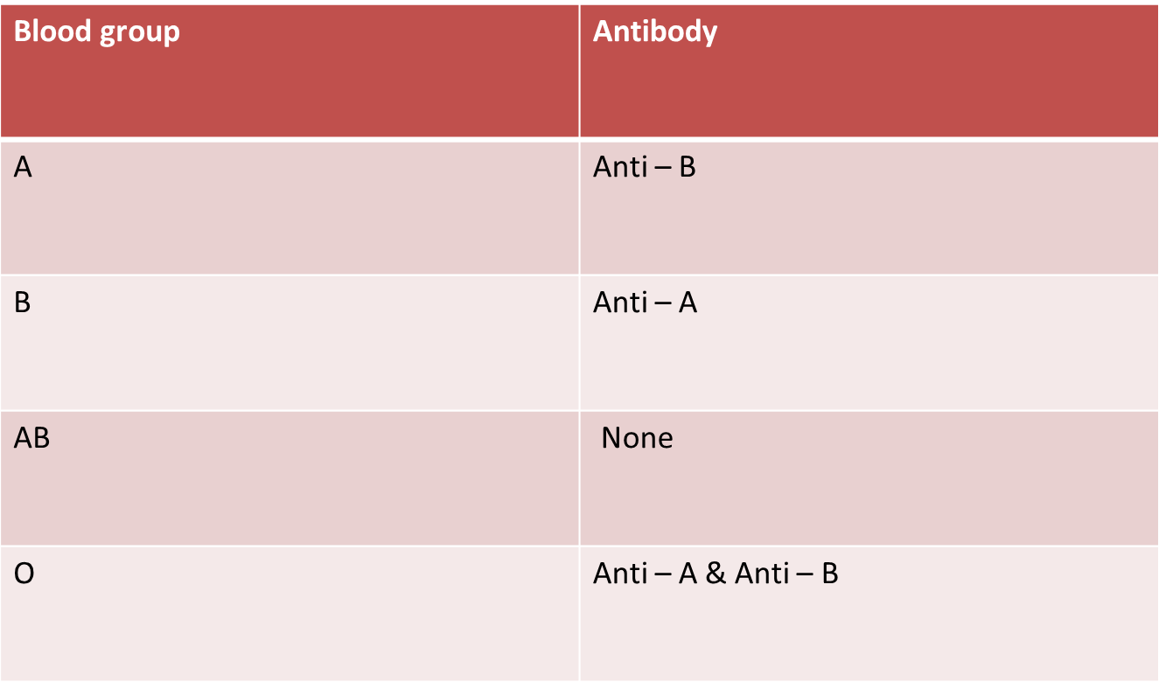

Slide 12
ABO System
Different Blood Types & their relative Frequencies :
O 47%
A 41%
B 9%
AB 3%

Slide 13
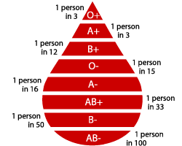

Slide 14
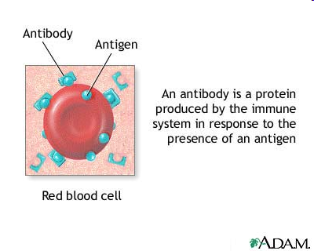

Slide 15
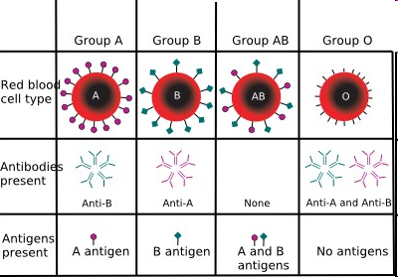

Slide 16
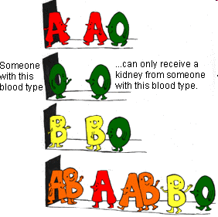

Slide 17
People with blood group O⁻ are called
"universal donors"
and people with blood group AB⁺ are called
"universal receivers."

Slide 18
Genotypes
Blood Types
AA or AO = Type A
BB or BO = Type B
OO = Type O
AB = Type AB

Slide 19




Inheritance of ABO blood groups
Blood groups are inherited from both parents.
The genes for A or B antigens are dominant to the gene for O.
The O gene is recessive
A and B express a special dominance relationship: codominance
The genes for A and B are often shown as and , and the recessive
gene for O is shown as the lowercase

Slide 20
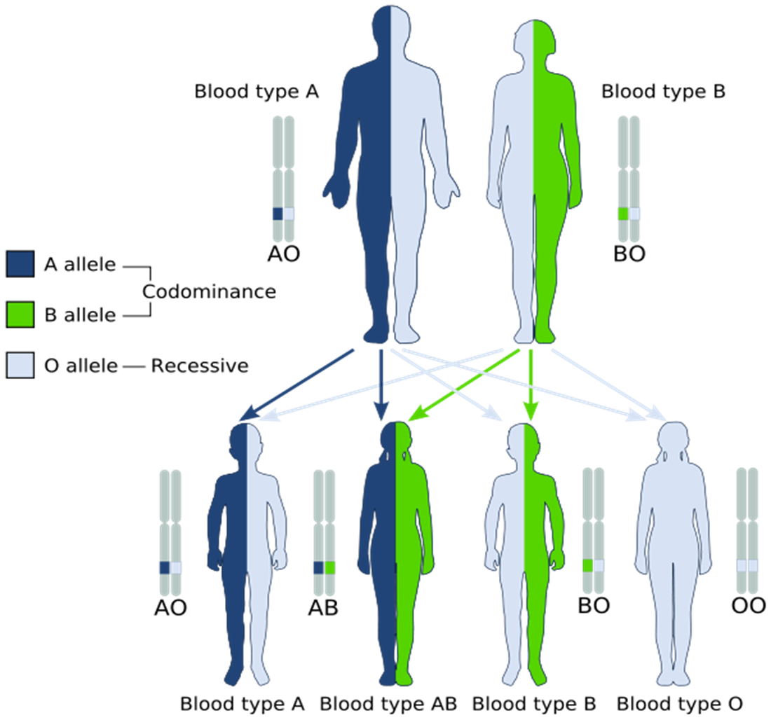

Slide 21
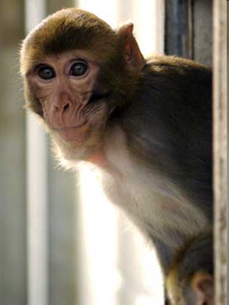
Rhesus Factor (Rh Factor )
Besides the ABO system, a person can be either…
Rh positive
Rh negative
(Classified according to
the presence or
absence of the Rhesus
factor(Antigen D)

Slide 22
Genotype for Rh group
Dd, dD, DD, persons are Rh(D) positive
Only dd persons are Rh(D) negative

Slide 23
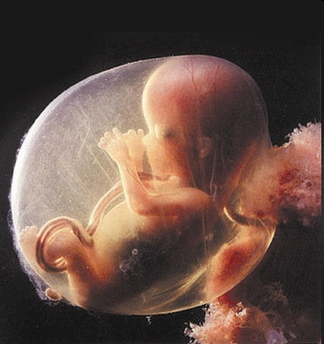
Rh and Pregnancy

Slide 24
Rh Factor
Normally a mother and her baby have separate blood systems
However, there are times when the baby’s blood may enter the mother’s system (at birth)

Slide 25
Rh and Pregnancy
If the mother is Rh negative and is exposed to her baby’s Rh positive blood, the mother’s body produces Antibodies against the baby’s red blood cells
This is not normally a problem during a first pregnancy because Antibodies haven’t had time to build up

Slide 26
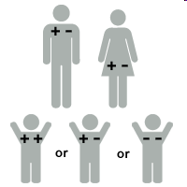
In the second pregnancy if it is Rh positive the antibodies can cross placenta and affect the baby.
So during subsequent pregnancies,
the mother is given
a drug to suppress
her reaction to the
baby’s Rh factor

Slide 27
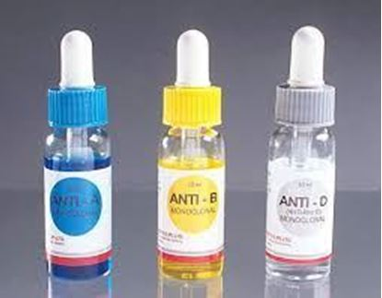
How is blood typing done?
Is used to determine the blood groups of an individual
Involves mixing the blood with three different reagents that have…
A antibodies
B antibodies
Rh antibodies

Slide 28
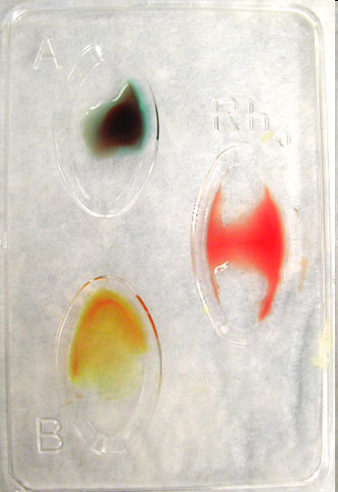
O Negative

Slide 29
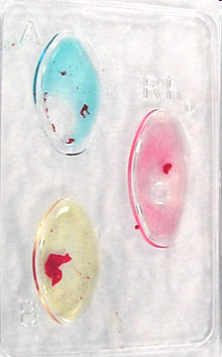
A
D (Rh)
B
AB Positive

Slide 30
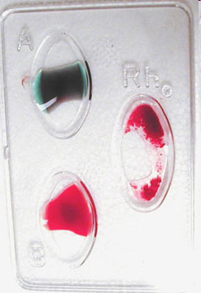
O Positive Blood

Slide 31


